Slide 1
TITLE OF PRESENTATION

Slide 2
WE ARE A PRODUCT DESIGN
& TECHNOLOGY COMPANY

Slide 3
WE MAKE THINGS BETTER
BY MAKING BETTER THINGS

Slide 4
Title of Presentation
www.goodsandservices.com
EST 2013
300+ PEOPLE
IN NORTH AMERICA & EMEA
Atlanta Mérida London

Slide 5
Title of Presentation
www.goodsandservices.com
ADD VALUE
BY CREATING EXPERIENCES PEOPLE LOVE
Service is our hallmark
Creativity is our spark
Craftsmanship is our passion

Slide 6
Title of Presentation
www.goodsandservices.com
3 PART SLIDE TITLE: DARK
Topic 1
Topic 2
Topic 3
Description
Description
Description

Slide 7
Title of Presentation
www.goodsandservices.com
3 PART SLIDE TITLE: LIGHT
Topic 1
Topic 2
Topic 3
Description
Description
Description

Slide 8
Title of Presentation
www.goodsandservices.com
5 PART SLIDE
Topic
Topic
Topic
Topic
Topic
Description
Description
Description
Description
Description

Slide 9
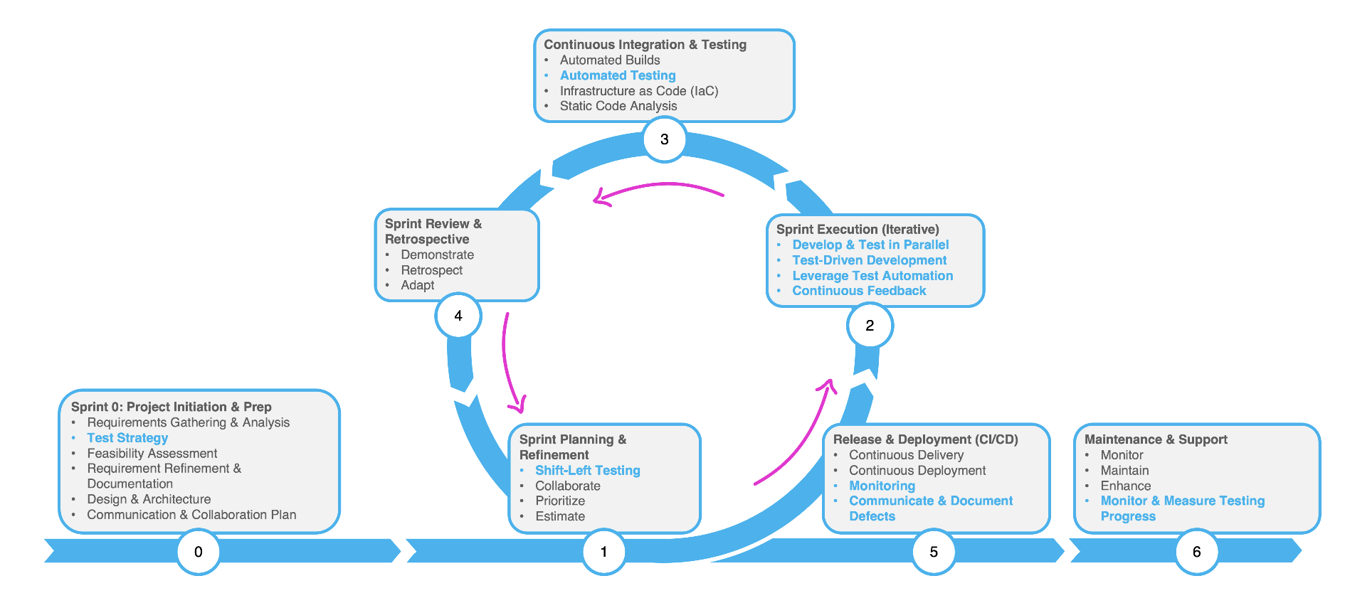
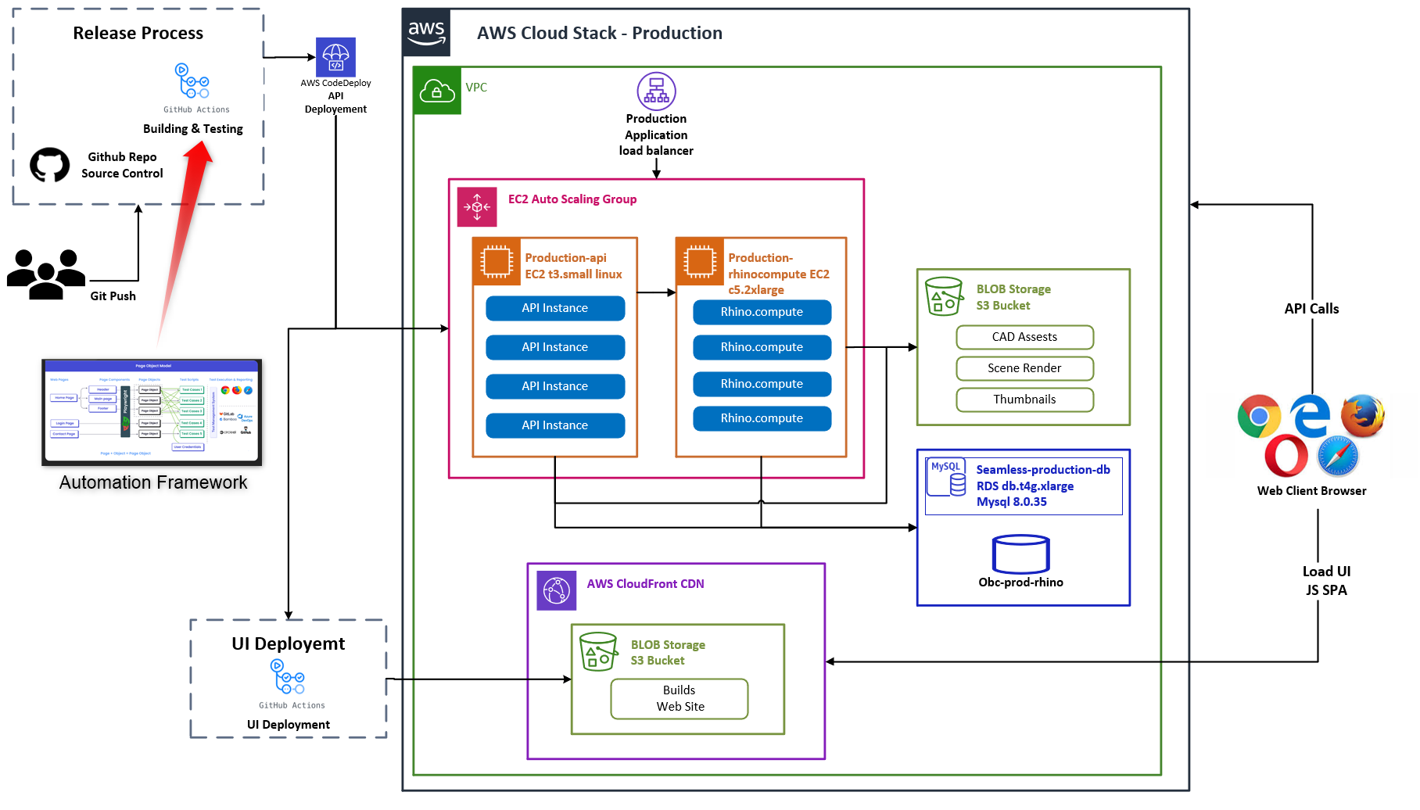
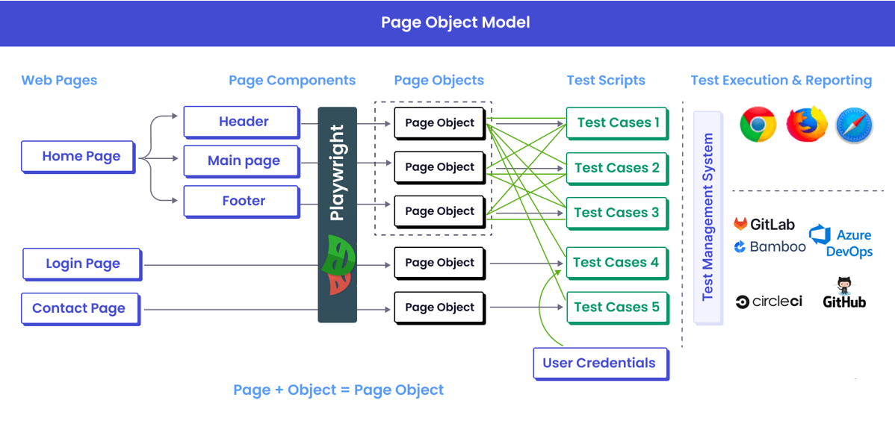
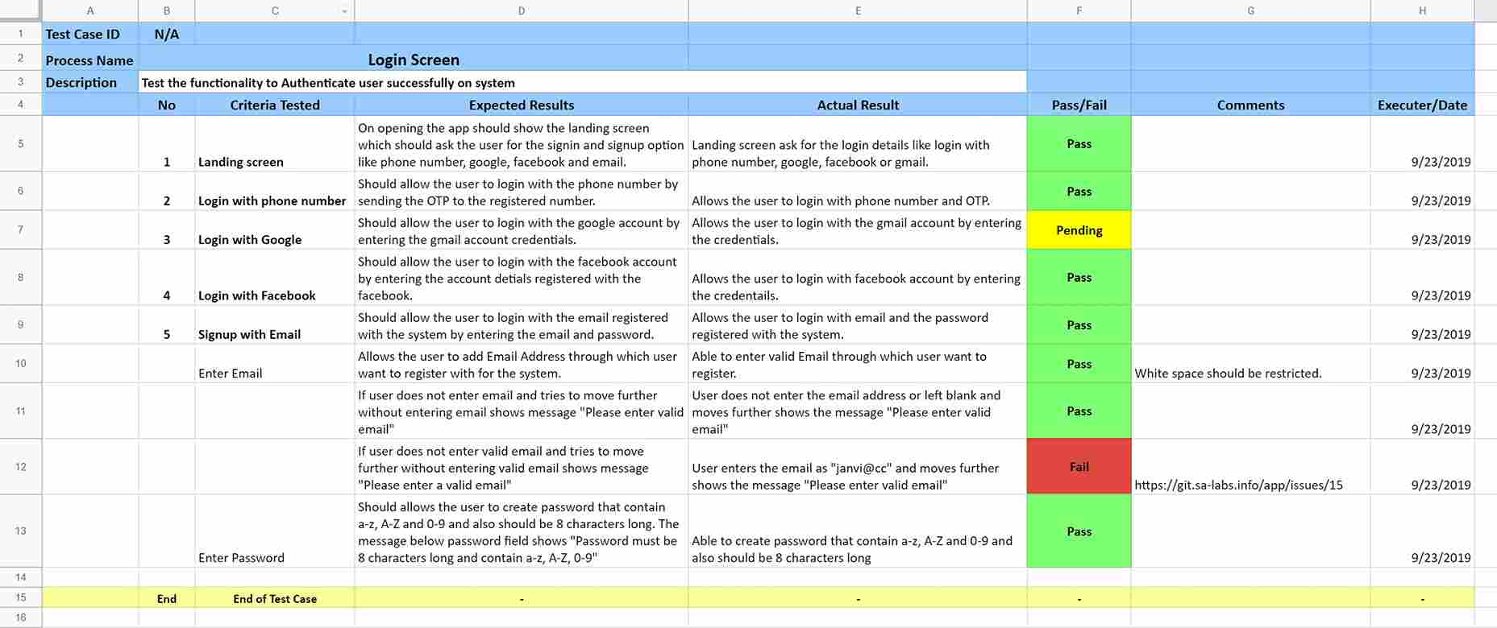
Title of Presentation
www.goodsandservices.com
PROCESS SLIDE
Step 1
Step 2
Step 3
Step 4
Description
Description
Description
Description

Slide 10
Title of Presentation
www.goodsandservices.com
READY TO ACCELERATE YOUR SOFTWARE DELIVERY?
Partner with us to achieve:
Higher quality software
Faster time to market
Reduced development costs
Increased team efficiency

Slide 11
Title of Presentation
www.goodsandservices.com
THANK YOU!

